Slide 1
FORECASTING ASSIGNMENT
SATYANARAYAN VENKAT NALDIGA
V01108247
09/04/2024

Slide 2
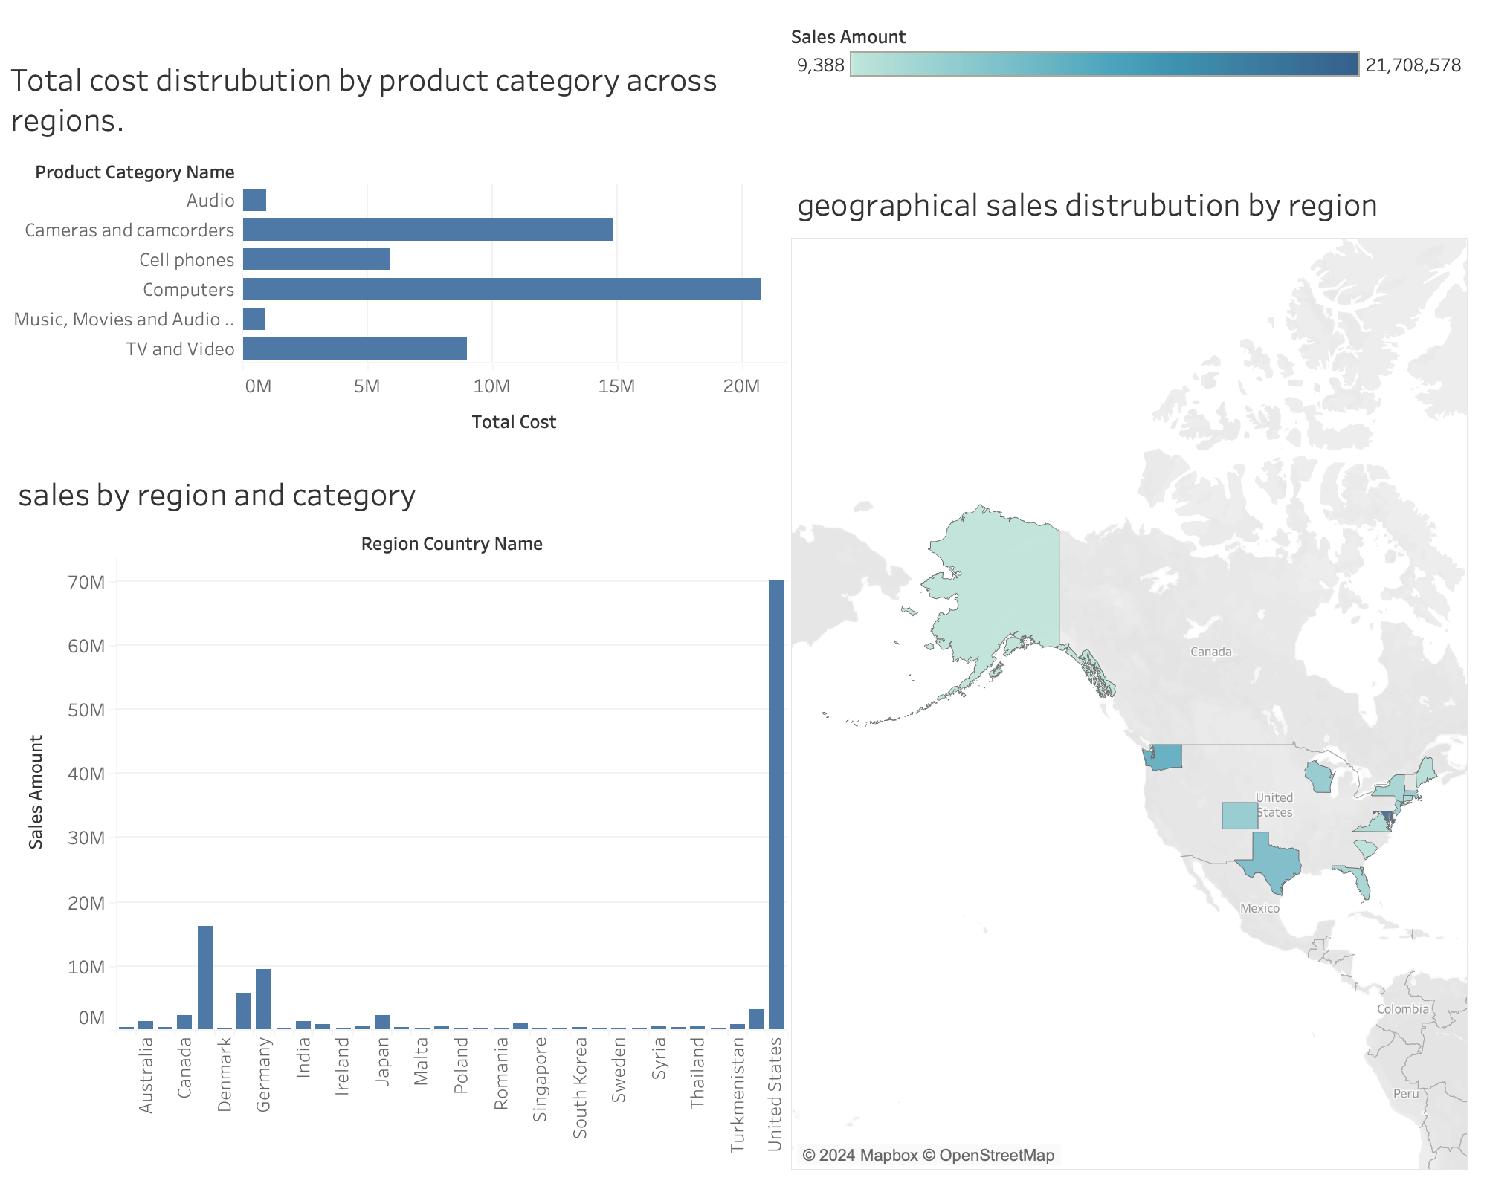

Slide 3
INTERPRETATION
1. Total Cost Distribution by Product Category Across Regions:
Dominance of Computers: The Computers category represents the largest portion of total cost, indicating a significant investment in this product category across regions.
Lower Cost for Cell Phones and Audio Products: Categories such as Cell phones and Audio products have a comparatively lower total cost, indicating potentially less focus or demand in these segments.
Moderate Investment in Cameras: Cameras and camcorders also show a substantial total cost, suggesting this category plays a key role in the overall product portfolio.
2. Sales by Region and Category:
U.S. as the Primary Sales Market: The United States overwhelmingly leads in sales, indicating that the business relies heavily on the U.S. market for revenue generation.
Limited Sales in Other Regions: Countries like Denmark, Canada, and Germany show some activity but contribute far less in terms of sales, highlighting a potential area for market growth and diversification.
Minimal to No Sales in Several Countries: Numerous countries, especially in Asia and Europe, show either minimal or no sales, pointing to untapped potential markets for expansion.

Slide 4
3. Geographical Sales Distribution by Region:
Concentration in North America: The map emphasizes a heavy sales concentration in the United States and a few other North American regions, reflecting a regional dependency.
Sparse Sales in Other Regions: Sales activity outside of North America is sparse, underscoring the opportunity to enhance presence in other global markets.
Opportunity for Global Expansion: The geographical distribution suggests significant room for international growth and expansion, particularly in regions with little to no current sales activity.
Conclusion:
The dashboard highlights a clear concentration of sales and investment in the U.S. market and the Computers product category. While the United States dominates both sales and total costs, the data suggests there is significant untapped potential in other regions and product categories. Countries outside of North America contribute minimally to overall sales, pointing to opportunities for geographic expansion and diversification. Furthermore, while Computers command the highest investment, other product categories such as Cell phones and Audio present areas where further strategic investment could lead to growth. To mitigate risk and sustain long-term growth, the organization should consider diversifying its market presence and exploring global expansion opportunities, particularly in regions where sales are currently low or non-existent.

Slide 5
THANKYOU

